Slide 1
Analyzing and predicting 311 requests of SF
Liang Chen
The data incubator

Slide 2
Motivation
Citizens can request service, report non-emergency concerns
Government could spot trends and anticipate future citizen needs
Predict request volume to reduce operation costs and improve customer experiences

Slide 3
Data source
Data | Find location | How to get | size
San Francisco 311 data | data.sfgov.org | Api | 2.92M rows, 19 columns, 961MB
San Francisco crime rate | data.sfgov.org | Api | 2.2M rows, 13 columns, 442 MB
San Francisco historical weather | NOAA | Download cvs | 0.2M rows, 23 columns, 9.5MB
National holiday | US calendar | Download cvs | 60 rows, 3 columns, 3KB

Slide 4
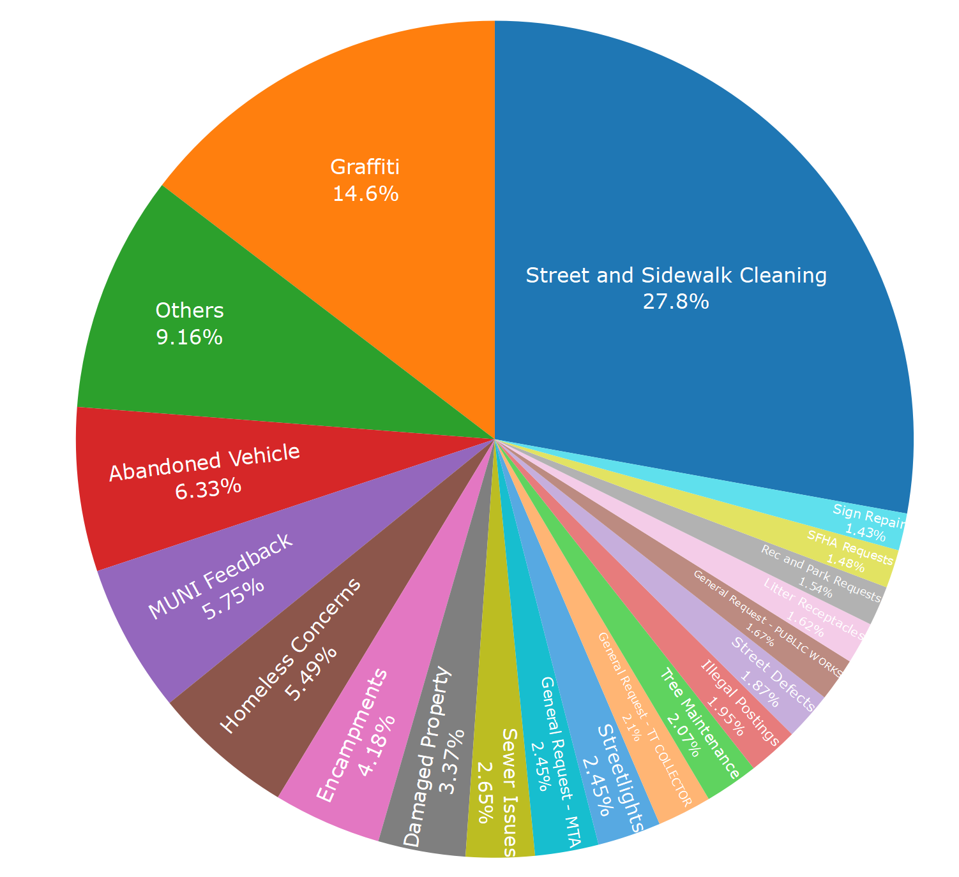
Percentage by Complaint Type Note that only the top 19 complaint types are displayed, the sum of the rest types is displayed as Others.

Slide 5
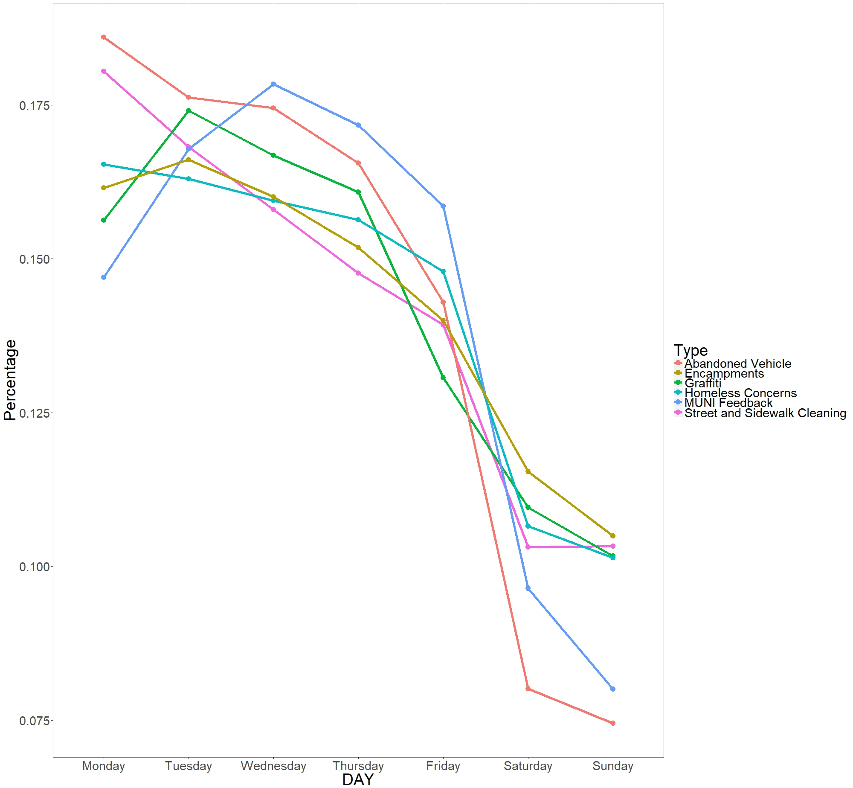
The request volumes of the top six complaint types distributed over days of the week.

Slide 6
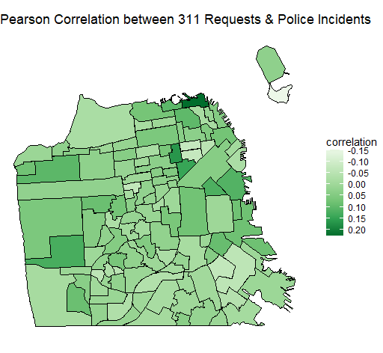
Police incidents may not explain the number of 311 requests

Slide 7
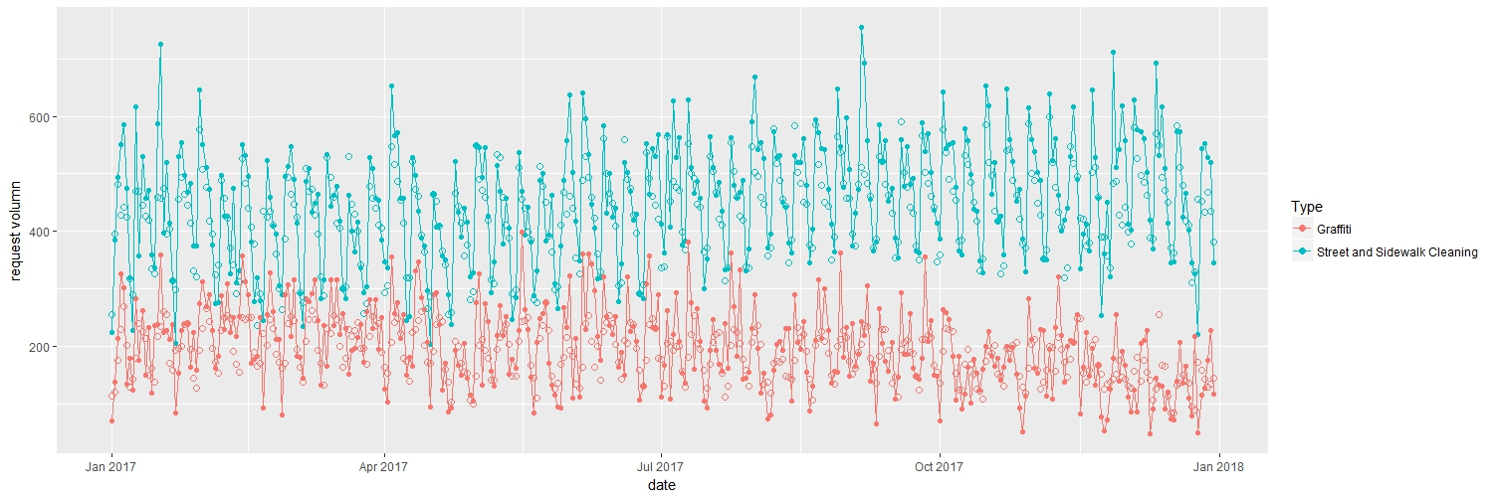
Comparison between the prediction of the daily request of 2017 and the reality The solid point shows the request volumes in the real data, and the circle represents the one from the prediction.

Slide 8
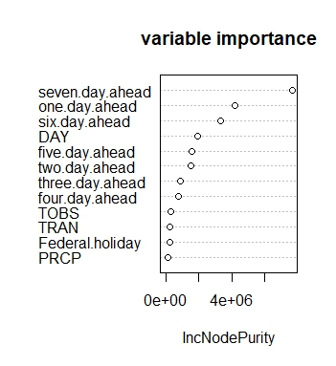
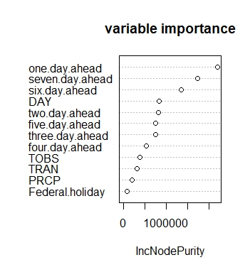
 | % variant explained | Prediction R square
Street and sidewalk cleaning | 0.8633 | 0.6414
Graffiti | 0.3691 | 0.2748

Slide 9
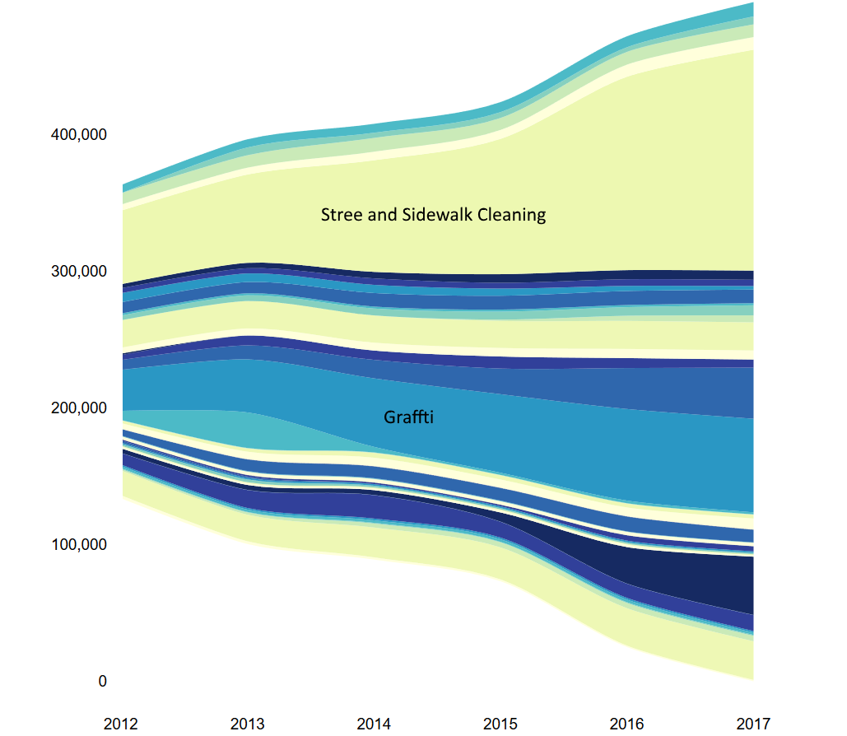
The prediction of the yearly accumulated 311 request volumes of the top 50 complaint types from 2012 to 2017

